Slide 1
Shaniqua Crump
Studio works

Slide 2
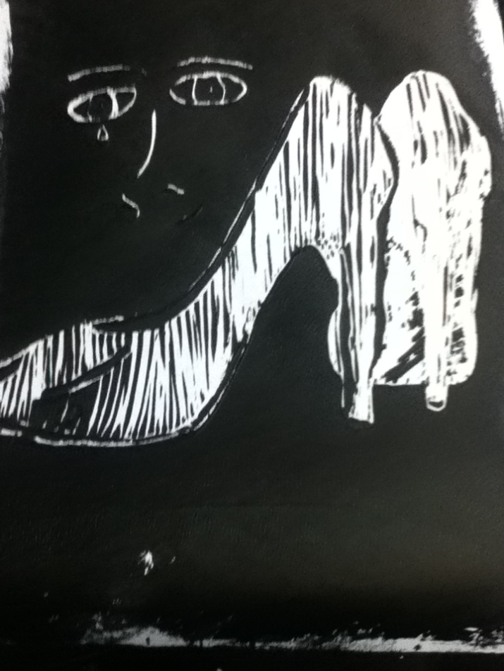
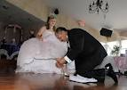
Block print
Quinceanera Latin Ceremony
Shoe Passion
Ink on Manoilum Block
September 2011

Slide 3
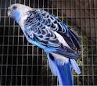
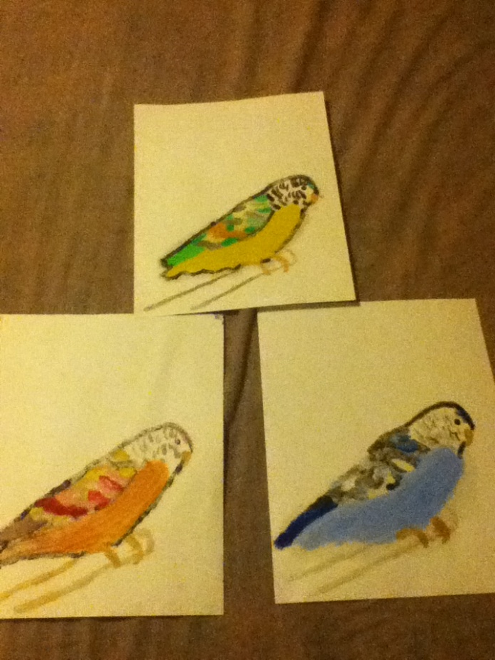
Mono Print
Bird on a Stick
Oil on Paper
September 2011
South American Culture

Slide 4
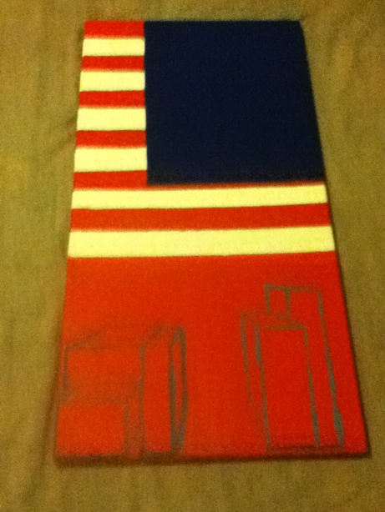
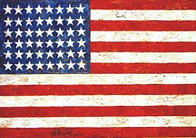
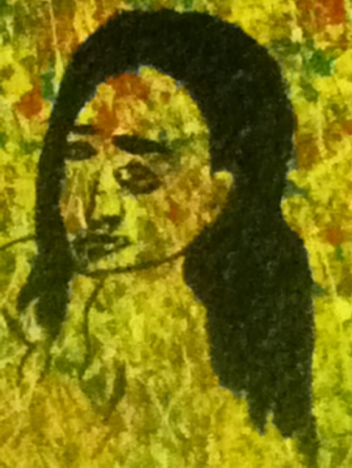
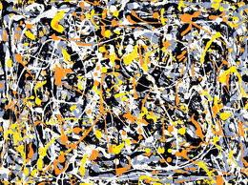
Diptyck
Jasper Johns
Artist in me
Acyclic on Canvas
September 2011
Jackson Pollock

Slide 5
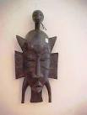
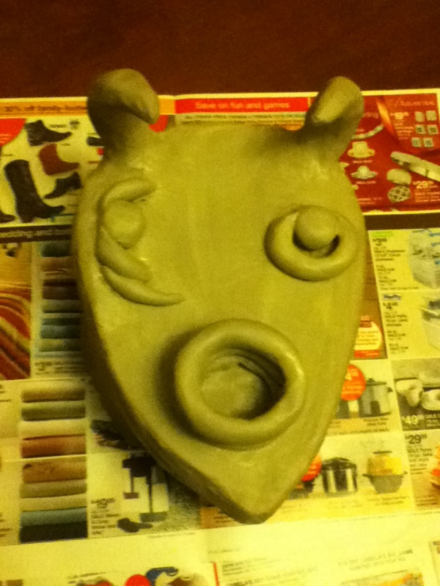
Sacred Vessel
Sacred African
Clay
December 2011
African Culture

Slide 6
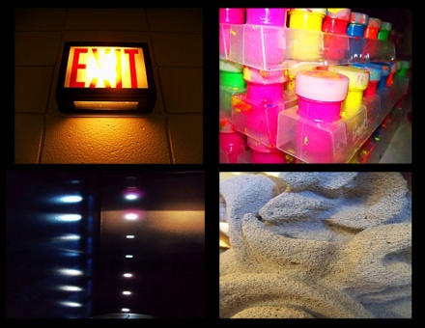
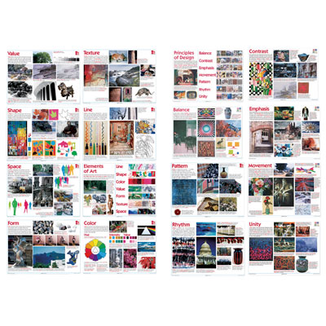
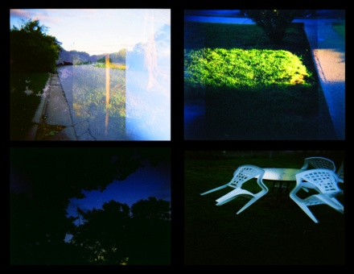
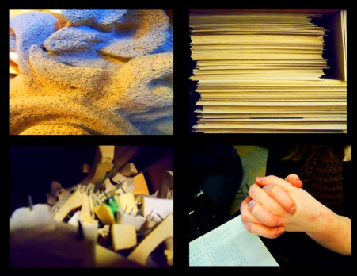
Holga
Everyday Sights
Photography
April 2012
Elements and P.O.D.

Slide 7
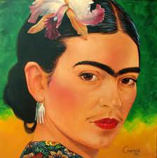
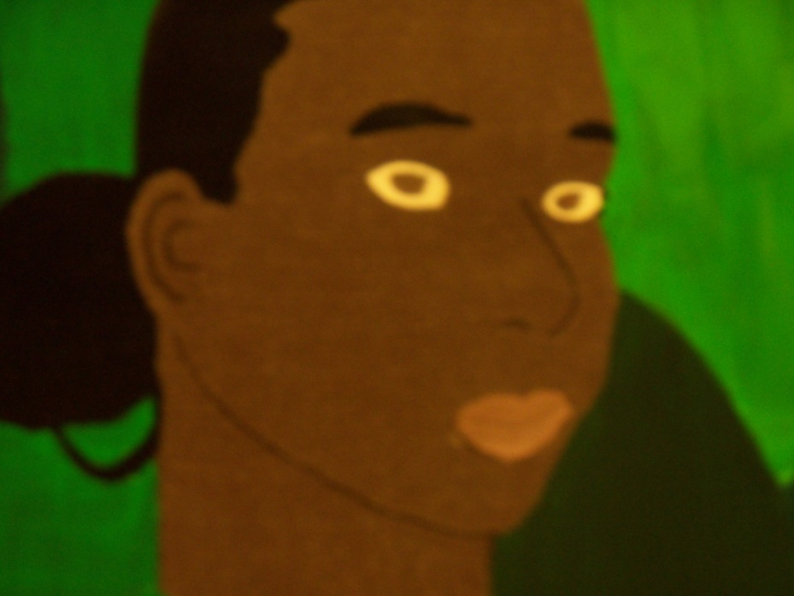
Self Portrait
Latia
Acrylic on Canvas
April 2012
Frida Khalo

Slide 8
Found Object
Hidden Pain
Acrylic
April 2012
The guy from MAID

Slide 9
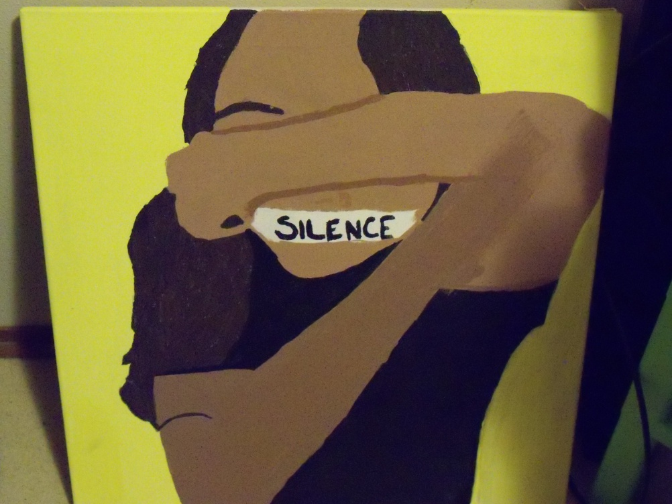
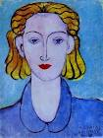
Painting Based On Photography
Slience
Acrylic on Canvas
March 2012
Henri Matisse

Slide 10
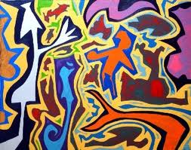
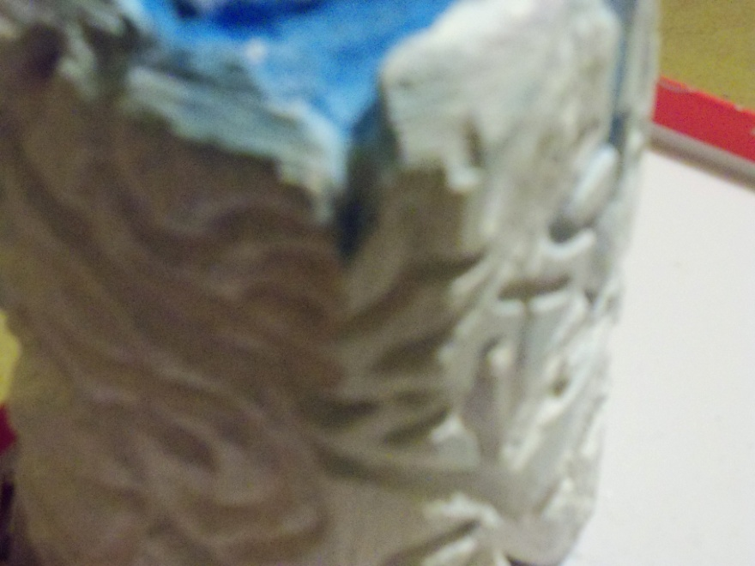
Organic Abstract Form
Waves
Plaster
March 2012
Keith Garrow

Slide 11
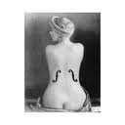
Choice Piece
Hidden Within Darkness
Acyclic on Canvas
March 2012
Man Ray

